Slide 1
Introduction to Data Science
Daniel Gutierrez, Data Scientist
Los Angeles, Calif.
Notes:
Welcome to the Introduction to Data Science course offered by AMULET Analytics.
My name is Daniel Gutierrez and I’m excited to be your instructor. I am a practicing data scientist from Los Angeles, Calif.

Slide 2
Course Outcomes
Provide an overview of Data Science
Discuss the Data Science Venn Diagram
Define the Data Science Process.
Present an Introduction to R Programming Part I
Start filling your data science toolbox with useful R programming techniques
Notes:
This is WEEK 1 of the Introduction to Data Science course. This WEEK covers introductory course materials as well as introduction to R programming Part I materials.

Slide 3
Lesson Objectives
Fully understand the Data Science Process
Provide a brief history of the R statistical environment
Discuss installing, configuring and using R and Rstudio
Talk about writing R scripts using basic language constructs and data types
Understand the atomic classes in R
Show how to code assignment statements
Define a number of useful R objects: vectors, lists, matrices, factors, data frames, arrays
Show how to create sequences
Review object attributes such as names and dimensionality
Discuss the importance of commenting your R code
Give examples of coercion
Show how to handle missing values: NA (not available), NaN (not a number) and NULL
Notes:
The learning objectives for WEEK 1 include:
- To fully understand the Data Science Process
- Provide a brief history of the R statistical environment
- Discuss installing, configuring and using R and Rstudio
- Talk about writing R scripts using basic language constructs and data types
- Understand the atomic classes in R
- Show how to code assignment statements
- Define a number of useful R objects: vectors, lists, matrices, factors, data frames, arrays
- Show how to create sequences
- Review object attributes such as names and dimensionality
- Discuss the importance of commenting your R code
- Give examples of coercion
- Show how to handle missing values: NA (not available), NaN (not a number) and NULL

Slide 4
Data Science vs. Data Engineering
A big confusion exists in our industry. What are the data scientist skillsets?
Many companies advertise for “data scientist” but expect a vast array of skills
Many companies actually seek a “unicorn”
Realistically, these companies need a data science “team” consisting of both data scientists plus data engineers
This class is for data scientists
Notes:
It is important for you to decide up front whether you wish to be a theorist or an experimentalist in data science. The theorist is someone who utilizes modest-sized data sets (or samples from large data stores), performs formal data analysis, data munging, exploratory data analysis, model selection, and validation in order to establish the theoretical foundations for the project. This person should have a firm understanding of machine learning and the mathematical principles behind it. This is the person for our Introduction to Data Science class.
The experimentalist, on the other hand, is more of a software engineer, or someone having experience building production software applications. This person should understand the mechanics of machine learning and how they can be deployed in production environments. This person might build Hadoop clusters, write MapReduce code, manage data storage hardware, write high-availability production code, and address the need for scalable hardware architectures. This is the person for a class in data engineering.
Data science is defined to include all of these specialties, which makes life confusing for employers and applicants. If a company advertises for data scientist, do they expect someone who can do sophisticated statistical analysis and manipulate large data sets and design/build scalable software systems? It is true that many companies wanting to hire a data scientist are holding out for such a unicorn.

Slide 5
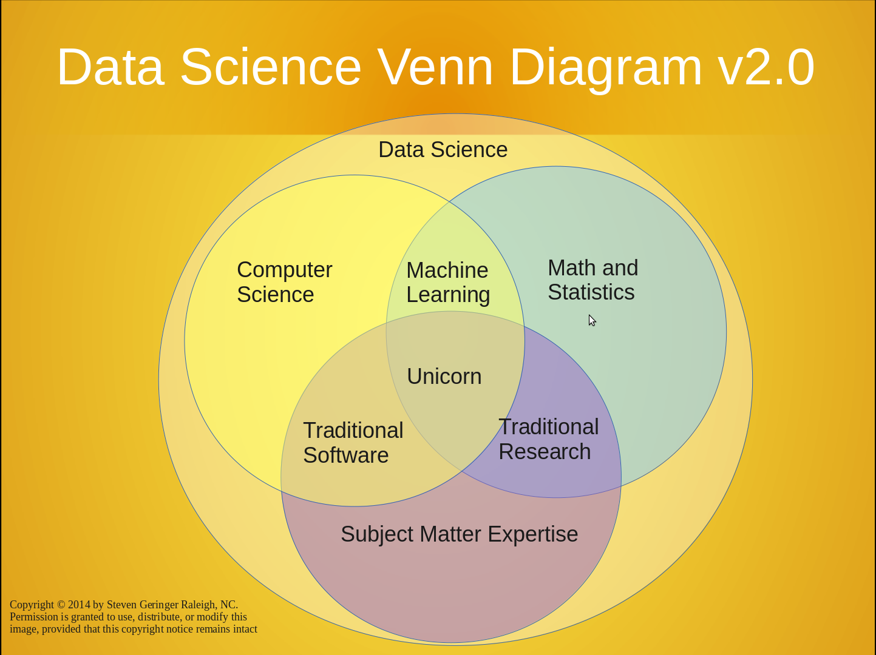
The Data Science Venn Diagram
Notes:
This is the Data Science Venn Diagram 2.0 . It is not meant to be a precise description of the overlap of disciplines, but only a graphic guideline. Notice that the unicorn central element represents a very rare intersection of all the disciplines.

Slide 6
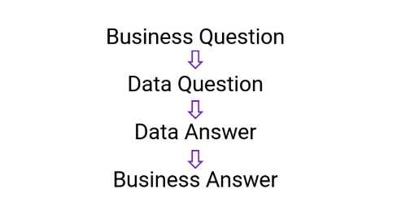
Data Science at a High Level

Slide 7
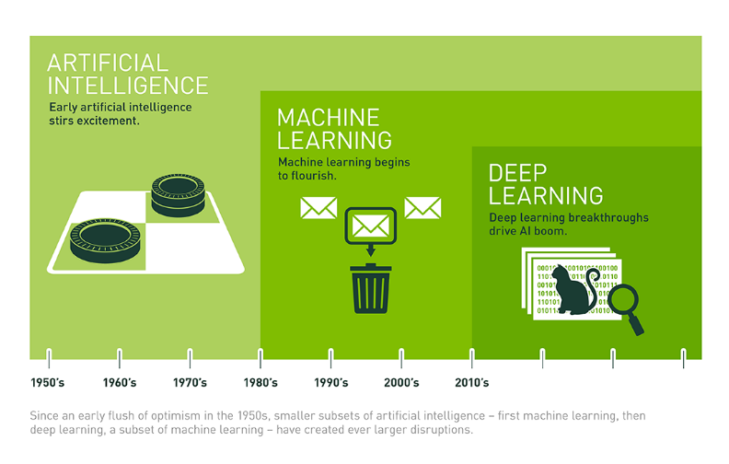
AI vs. ML vs. DL

Slide 8
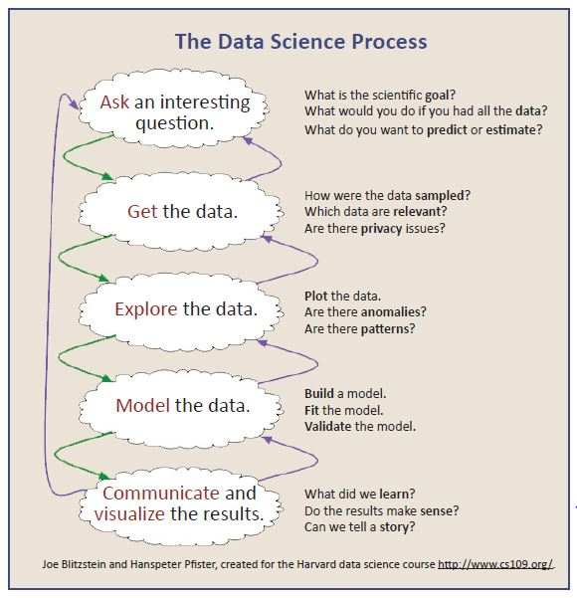
Data Science Process
Notes:
Let’s go over the data science process step-by-step, as it will serve as a template for the rest of the course. As you gain more experience, you’ll want to enhance this basic model with more nuanced approaches, but even with adjustments, the process will be largely the same.
This is the diagram from page 22 from my book.

Slide 9
Not So Brief History of R
What is R?
Historically, R is a dialect of the S language
S is a language that was originally developed by John Chambers and others at Bell labs
S was initiated in 1976 as an internal statistical analysis environment – originally implemented as Fortran libraries
Early versions of the language did not contain functions for statistical modeling
In 1988 the system was rewritten in C and began to resemble the system that we have today (this was Version 3 of the language). The book Statistical Models in S by Chambers and Hastie (the white book) documents the statistical analysis functionality.
Notes:
Recording OK

Slide 10
Not so Brief History of R (continued)
Version 4 of the S language was released in 1998. The book Programming with Data by John Chambers (the green book) documents this version of the language
In 1993 Bell Labs gave StatSci (now Insightful Corp.) an exclusive license to develop and sell the S language
In 2004 Insightful purchased the S language from Lucent for $2 million
Insightful sells its implementation of the S language under the product name S-PLUS
In 2008 Insightful is acquired by TIBCO for $25 million (TIBCO is a prominent player in the R market today)

Slide 11
Not so Brief History of R (continued)
1991: Created in New Zealand by Ross Ihaka and Robert Gentleman. Their experience developing R is documented in a 1996 JCGS paper
1993: First announcement of R to the public
1995: Martin Mächler convinces Ross and Robert to use the GNU General Public License to make R free software
1997: The R Core Group is formed (containing some people associated with S-PLUS). The core group controls the source code for R
2000: R Version 1.0.0 is released
2019: R version 3.6.2 is released on Dec. 12, 2019

Slide 12
Not so Brief History of R (continued)
Quite lean, as far as software goes; functionality is divided into modular “packages”
Graphics capabilities very sophisticated and better than most stat packages.
Useful for interactive work, but contains a powerful programming language for developing new tools (user → programmer)
Very active and vibrant user community; R-bloggers (www.r-bloggers.com) and Stack Overflow (www.stackoverflow.com)

Slide 13
The R Environment
The R system is divided into 2 conceptual parts:
The “base” R system that you download from the CRAN website
Everything else!
The “everything else” consists of many other packages:
There are more than 15,365 packages on CRAN that have been developed by users and programmers around the world.
People often make special purpose packages available on their personal websites; there is no reliable way to keep track of how many packages are available in this fashion.
Notes:
The R system is divided into 2 conceptual parts:
First, there is the “base” R system that you download from the CRAN website
Next, is everything else!
The “everything else” consists of many other packages:
There are currently 15,365 packages on CRAN that have been developed by users and programmers around the world.
People often make special purpose packages available on their personal websites; there is no reliable way to keep track of how many packages are available in this fashion.
The beauty of R is the growing number of packages that supplement the base R functionality.

Slide 14
The R Environment
In order to use an R package you must first determine if it exists
Find the package via Google e.g. “time series in R”
Use CRAN page such as: http://cran.r-project.org/web/packages/timeSeries/index.html
Download “Reference Manual” and vignettes (if any)
> install.packages(“timeSeries”)
> library(timeSeries)
Notes:
In order to use an R package you must first determine if it exists.
You can search for a package via Google. For example, if you’re seeking a package that can help you with performing time series analysis with R, just enter the Google keywords “time series in R”. In some cases, you may find more than one package for an area of desired functionality.
The Google search results often will point you to the CRAN website with a link for where you can download package documentation such as a “Reference Manual” or a vignette (if any). A vignette is a very useful document that is more like a tutorial complete with R code examples.
In order to install the package your local system, you use the following commands:
> install.packages(“timeSeries”)
> library(timeSeries)

Slide 15
The R Environment
Available from CRAN (http://cran.r-project.org)
The Comprehensive R Archive Network
An introduction to R
Writing R packages
R data import/export
R installation and administration (mostly for building R from source code)
R internals (not for the faint of heart)
Notes:
The open source R statistical environment can be obtained from the CRAN website – cran.r-project.org
CRAN stands for the Comprehensive R Archive Network
CRAN includes all the necessary software to run R on Windows, MACOS and Linux computer.
It also include “Introduction to R” materials, information on writing your own R packages, information on R data import and export, R installation and administration materials (mostly building R from source code), and R internals – materials not for the faint of heart since they are very low-level.

Slide 16
Installing R
Download R from CRAN (http://cran.r-project.org)
Select your environment: Windows, Mac, or Linux
Click on “Install R for the first time”
Click on “Download R 3.6.2 for Windows” for example
Follow the useful installation prompts
NOTE: you must install R before RStudio

Slide 17
Installing RStudio
Download the RStudio IDE from http://www.rstudio.com/
Click on “Download RStudio” button
Click on “RStudio Desktop”
Click on “Download RStudio Desktop” button
Click on the installer that matches your system
Follow the useful installation prompts
You should now see both the R and RStudio icons on your desktop

Slide 18
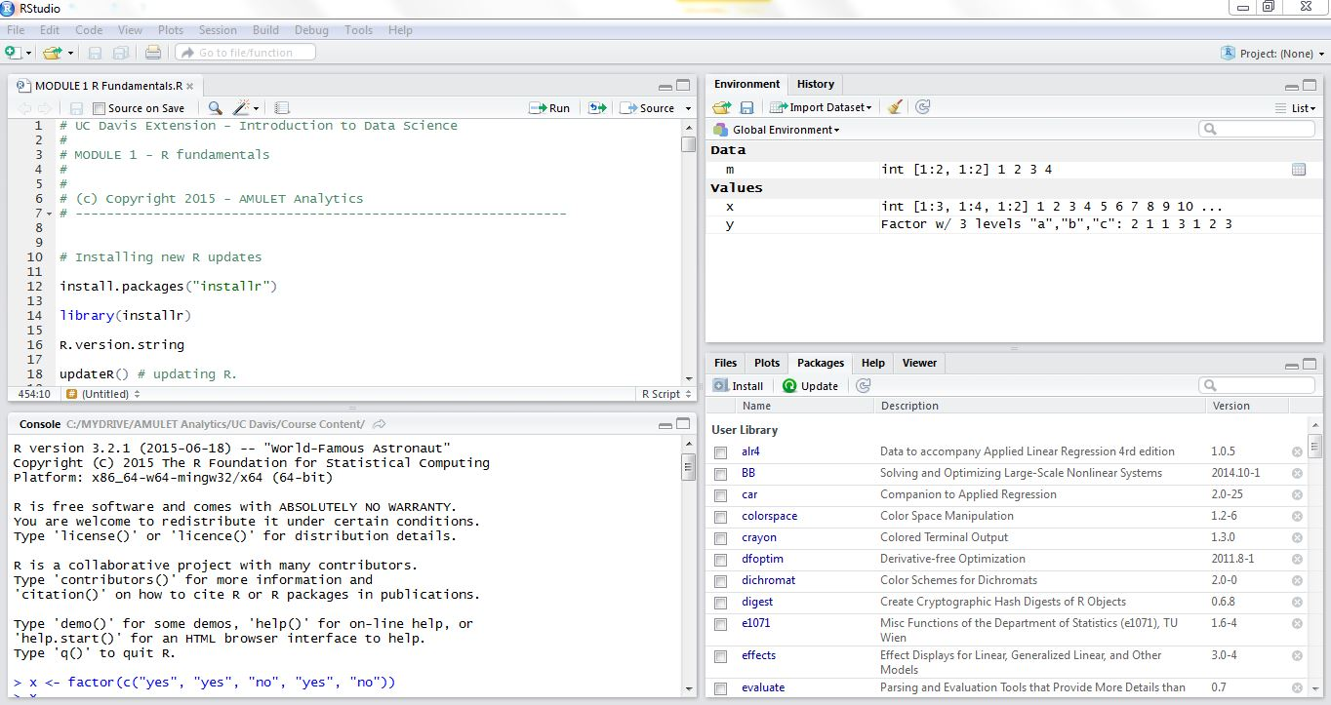
R Fundamentals – Part 1
Notes:
The R Studio screen is divided into four pane areas. The upper left pane is the R script editor, where you can type your R programming code into separate code files. You can have multiple code files open at once, so you can copy code from one script to another. In order to run lines of R code, all you need to do is highlight the lines with your mouse and click on the Run tool in the editor’s tool bar. When you run code, the lines will appear in the lower-left pane, which is the R console. Each line is preceded with the “>” symbol. Here you’ll also see any effect of the code you run.
In the top-right pane, you’ll see the Environment tab, which contains two sections: Data, showing all the active data sets, and Variables, showing all the program variables created by your R scripts. Note that if you click on a data set name, a new data browser appears in the upper-left pane so you can scroll through data items found in the data set.
In the bottom-right pane, you’ll see a number of different tabs: Files, Plots, Packages, Help, and Viewer. The results of all plot features are directed to this pane. Help information is also directed to this pane. You can also see all the active packages in your R environment.

Slide 19
R Fundamentals – Part 1
Tips on Developing with R
On your local machine, set up a distinct folder (directory) for each R project. Don’t mix R projects in the same folder
Use Session -> Set Working Directory in RStudio to point to your project folder
Use File -> New File -> R Script to open up a new R script in the code editor
Start coding and using the R command line
Use Session -> Save Workspace As to create an environment file containing all your variables. This will be named with the name you provide plus an .RDATA extension
Next time, start up Rstudio with the .RDATA file to resume
Notes:
Let’s go over some useful tips on developing with R
On your local computer, you should set up a distinct folder (or directory) for each R project. It is best not to mix R projects in the same folder.
You can use the menu functions Session and Set Working Directory in Rstudio to point to your project folder.
You can use the menu functions File, New File, and R Script to open up a new R script file in the code editor.
Now you can start coding and using the R command line
You can use the menu functions Session and Save Workspace As to create an environment file containing all your variables. This file will be named with the name you provide plus an .RDATA extension
Next time, you can start up Rstudio with the .RDATA file to resume work.

Slide 20
R Fundamentals – Part 1
R has five basic or “atomic” classes of objects:
Character
Numeric (real numbers)
Integer
Complex
Logical (True / False)
The most basic object is a vector
A vector can only contain objects of the same class
BUT: The one exception is a list, which is represented as a vector but can contain objects of different classes (indeed, that’s usually why we use them)

Slide 21
R Fundamentals – Part 1
At the R command prompt we generally type what are called expressions. You type the expression and R evaluates it.
The <­­- symbol is the assignment operator (very similar in function to = assignment operator found in other programming environments) which assigns what’s on the right to what’s on the left
The # character indicates a comment. Anything to the right of the # (including the # itself) is ignored as part of the R expression. Commenting your R scripts is highly recommended!

Slide 22
R Fundamentals – Part 1
Numbers in R are generally treated as numeric objects (i.e., double precision real numbers)
If you explicitly want an integer, you need to specify the L suffix
Ex: Entering 1 gives you a numeric object; entering 1L explicitly gives you an integer.
There is also a special number Inf which represents infinity; e.g. 1 / 0; Inf can be used in ordinary calculations; e.g. 1 / Inf is 0
The value NaN represents as undefined value (“not a number”); e.g. 0 / 0; NaN can also be thought of as a missing value (more on that later)
Notes:
Recording OK

Slide 23
R Fundamentals – Part 1
In addition to the atomic types, here are some additional object types available in R:
Vectors
Lists
Matrices
Factors
Data frames
Arrays
Notes:
In addition to the atomic types listed above, here are some additional data types available in R:
Vectors – a vector is the fundamental data type in R. It is a one-dimensional series of values of the same type
Lists – in contrast to a vector, a list can combine objects of different types.
Matrices – a matrix is a vector with two additional attributes: the number of rows and the number of columns. Matrices are two-dimensional collections of values of the same type
Factors – special object type for categorical variables that are common in statistics
Data frames – probably the most important object type for data scientists. This is the object that holds a data set in R. It is like a matrix, with a 2 dimensional rows-and-columns structure. However it is different from a matrix in that each column may be a different data type.
Arrays – an array is like a higher-dimensional matrix.

Slide 24
R Fundamentals – Part 1
R objects also can have attributes
Names
dimnames
Dimensions (e.g., matrices, arrays)
Class
Length
Other user-defined attributes/metadata
Notes:
R objects also can have various attributes, such as
Names,
Dimnames in the case of objects having dimensions,
Dimensions for matrices, and arrays
Class,
Length.
As well as other user-defined attributes/metadata

Slide 25
R Fundamentals – Part 1
Matrices are vectors with a dimension attribute. The dimension attribute is itself an integer vector of length 2 (nrow, ncol)
Matrices are constructed column-wise, so entries can be thought of starting in the “upper left” corner and running down the columns.
Lists are a special type of vector that can contain elements of different classes. The List is a very important data type in R and you should get to know them well.
Notes:
Matrices are vectors with a dimension attribute. The dimension attribute is itself an integer vector of length 2 consisting of the number of rows and the number of columns, and designated in R by (nrow, ncol)
Matrices are constructed, or filled in, column-wise, so entries can be thought of starting in the “upper left” corner and running down the columns.
Lists are a special type of vector that can contain elements of different classes. The List is a very important data type in R and you should get to know them well.

Slide 26
R Fundamentals – Part 1
Factors are used to represent categorical data. Factors can be unordered or ordered. One can think of a factor as an integer vector where each integer has a label.
Factors are treated specifically by modelling functions like lm() and glm()
Using factors with labels is better than using integers because factors are self-describing; having a variable that has values “Male” and “Female” is better than a variable that has values 1 and 2.
Notes:
Factors are used to represent categorical data. Factors can be unordered or ordered.
One way to think of a factor is as an integer vector where each integer has a label.
Factors are treated in specific ways by algorithms like lm() and glm()
Using factors with labels is better than using integers because factors are self-describing; for example, having a variable that has values “Male” and “Female” is better than a variable that has values 1 and 2.

Slide 27
R Fundamentals – Part 1
Missing values are denoted by NA or NaN for undefined mathematical operations (e.g. division by zero).
is.na() is used to test objects if they are NA
is.nan() is used to test for NaN
NA values have a class also, so there are integer NA, character NA, etc.
A NaN value is also NA but the converse is not true
Notes:
Many times you’ll encounter a data set that is incomplete, that is, certain variables may have missing values. Missing values in data sets are denoted by special values in R. NA is the general way R denotes a missing value, or NaN for undefined mathematical operations (e.g. division by zero).
The function is.na() is used to test objects to see if they are NA. is.na() returns TRUE if a missing value is found.
The is.nan() function is used to test for the NaN value. Is.nan() returns TRUE if a “not a number” missing value is found.
NA values have a class as well, so there are integer NA, character NA, etc.
In the associated Code Module we’ll see a lot of detail about missing values. For now, just remember that the NaN value is also NA but the converse is not true

Slide 28
R Fundamentals – Part 1
Data frames are used to store tabular data
They are represented as a special type of list where every element of the list has to have the same length
Each element of the list can be thought of as a column and the length of each element of the list is the number of rows
Unlike matrices, data frames can store different classes of objects in each column (just like lists); matrices must have every element be the same class
Data frames also have a special attribute called row.names
Data frames are usually created by calling read.table() or read.csv()
Can be converted to a matrix by calling data.matrix()
Notes:
Data frames the most important part of the R language for data scientists since you’ll do most of your work on data frame objects. Machine learning algorithms typically work with data frames.
Data frames are represented as a special type of list where every element of the list has to have the same length
Each element of the list can be thought of as a column and the length of each element of the list is the number of rows
Unlike matrices, data frames can store different classes of objects in each column (just like lists); matrices, on the other hand, must have every element be the same class
Data frames also have a special attribute called row.names where you’re able to assign meaningful names to each row, like say a customer name.
Data frames are usually created by calling the read.table() or read.csv() functions
Lastly, if the need arises, data frames can be converted to a matrix by calling the data.matrix() function

Slide 29
R Fundamentals – Part 1
Our goal for course Weeks 1 through 4 is to present a collection of R fundamentals and start filling your data science toolbox with a collection of programming techniques
Notes:
Our goal for course Weeks 1 through 4 is to get you up to speed with R. We’ll present a collection of R fundamentals and start filling your data science toolbox with a collection of useful programming techniques that you can reuse in the future.
Understand that R is a very large subject and it takes months of concerted use to become comfortable with the language. This is true even for seasoned programmers. R is an unusual programming language in a number of ways and the best way to learn it is to use it. Further, you’ll see that there are many ways to do the same thing in R.
By the end of Week 4 you will have seen most of the important parts of the R language.

Slide 30
Code Modules
WEEK 1-1 Code Module – updating R
WEEK 1-2 Code Module – vectors
WEEK 1-3 Code Module – coercion
WEEK 1-4 Code Module – matrices
WEEK 1-5 Code Module – lists
WEEK 1-6 Code Module – factors
WEEK 1-7 Code Module – missing values
WEEK 1-8 Code Module – data frames
WEEK 1-9 Code Module – names
WEEK 1-10 Code Module - arrays
Notes:
In order to demonstrate the concepts for WEEK 1, we’ll step through a series of in-depth R code examples found in the Code Modules listed.
I encourage you to take the R script file for WEEK 1 and try each code snippet yourself. Take some time to tweak each example and try different things so you’ll fully understand each programming concept.

Slide 31
Summary
In WEEK 1 of Introduction to Data Science, we presented all of the introductory material for the course including the Data Science Venn diagram, and the Data Science Process.
We also introduced R by giving a short history of the language as well as instructions for installing both R and RStudio.
Next, we start our journey through the R language by learning some basics.
Notes:
In WEEK 1 of Introduction to Data Science, we presented all of the introductory material for the course including motivation for the Pure Data Science track versus the Big Data Engineering track, the Data Science Venn diagram, and the Data Science Process.
We also introduced R by giving a short history of the language as well as instructions for installing both R and RStudio.
Next, we start our journey through the R language by learning some basics to get ready for programming the data science process.

